Slide 1
Exporting CWB Data
Notes:
This is the sixteenth presentation in the 18-part series for CWB training. The following slides cover exporting the CWB data and uploading the data back into DCPDS.

Slide 2
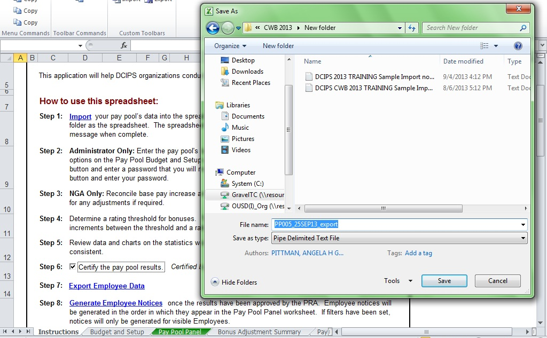
Export CWB
Notes:
Click on “Export Employee Data” link to generate export file for DCPDS upload. Save it where you can find it later. The best place is in the same folder where you store your CWB.

Slide 3
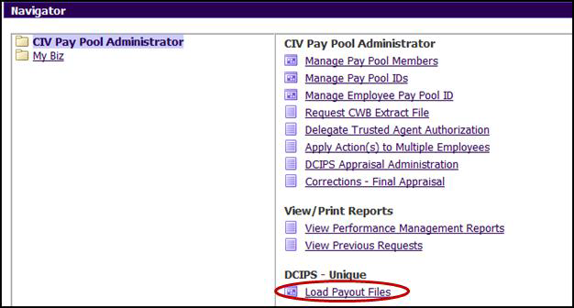
Upload CWB Export File
Select CIV Pay Pool Administrator from the Navigator menu
Select Load Payout Files under the CIV Pay Pool Administrator menu
Notes:
This slide shows the necessary steps to upload the CWB export file into DCPDS.

Slide 4
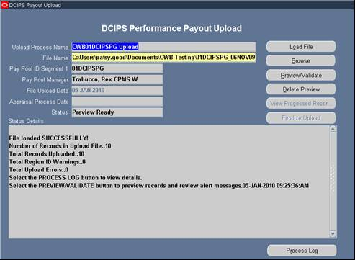
Upload CWB Export File
See DCIPS CWB Extract_Upload User Guide Fall 2016 for complete step by step instructions on uploading certified CWB export files and full discussion of upload error codes
Notes:
Follow the guidance provided in your Extract Tool Guide in order to finish uploading the CWB export file.

Slide 5
To continue CWB training, view next presentation
“Generating Feedback Notices”
Notes:
This concludes the sixteenth presentation in the 18-part series for CWB training. To continue training, view the next Presentation, entitled Generating Feedback Notices.

